Slide 1
Student Results Management System
Jai Pratap Singh Bhadouriya
(2000290140053)
Manish Kumar Ruhela
(2000290140064)
Ranjeet Singh
(2000290140099)
Supervisor Name-: Mr. Amit Kumar Goyal

Slide 2
Abstract:-
The project titled “STUDENT RESULT MANAGEMENT SYSTEM” is a web based application developed to maintain the results of the students.
This project contains three modules. register/login module, admin module and student module. Admin module is used to create and manage the subjects ,classes and Add the students and their results. Student module used to provide the results of the students and can download the results.
Registered users can access the database of the students.
which will provide details about subjects, classes, results, And student can download results .which is useful for the students.

Slide 3
Existing system:-
Existing process of the getting information for the student is done manually.
All the wanted information need to be provided by the administration.
If the students want to know the results of the particular subject so their should wait for long time because work done manually.
The information about their courses , results and other information accessing is not possible.

Slide 4
Drawbacks:-
This system is very time taking process.
And the data can’t be accessed accurately.
If the student want more information about their courses the admin cant be able to provide that.
Student need to go manually for getting the information.
This system is complex.

Slide 5
Proposed system:-
We have successfully proposed the “STUDENT RESULT MANAGEMENT SYSTEM” for replacing the manual work of the administration.
By this application student can easily access the modules like student results and courses other information required to student.
This application is flexible and can easily access by the student .
So the time taken for getting the information will be reduces.

Slide 6
SYSTEM REQUIREMENTS:- HARDWARE REQUIREMENTS:- HARD DISK : 150GB RAM :2GB PROCESSOR :INTEL COREi5 1.8GHZ

Slide 7
SOFTWARE REQUIREMENTS:- OPERATING SYSTEM :WINDOWS10 FRONT END : PHP with bootstrap BACK END : MYSQL TOOLS :XAMPP(cross-platform ,apache, MYSQL,PHP,PERL)

Slide 8
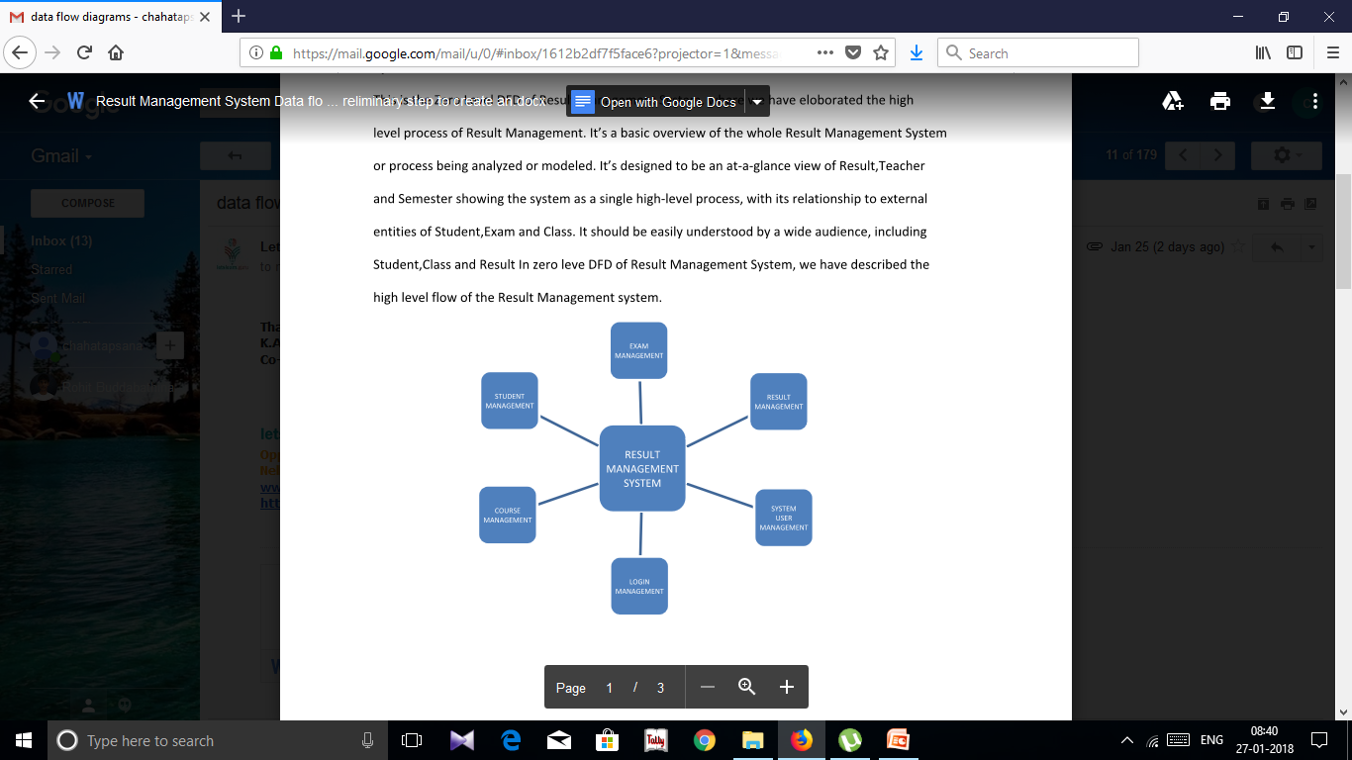
SYSTEM ARCHITECTURE:-

Slide 9
Modules:-
1.Register/Login Module
2.Student Module
3.Admin Module

Slide 10
1.Resgister/login Module:-
The Home page of the “STUDENT RESULTS MANAGEMENT SYSTEM”.
It consists of Two portal about student and admin..
Login page is used to login to the admin portal.
2.Student Module:
students can view the results.
student can download the results..

Slide 11
3.Admin Module:
Create and manage the subjects , classes and can add the students
and their results of the students.
Reports for various modules
Update or deleting the admin information

Slide 12
THANK YOU……..

